Slide 1

Battery Model Mathematical Formulation
Objective Function
………………………………………………………………………(1)
Power Gating Constraint
……………………………………………………(2)
Where the smoothing terms are defined as:
Actual Power and SOC Dynamics
……………………………………..…………………………...……(3)

Slide 2

Decision Variables & Bounds
Four variables are defined at each time step t = 0, …, T−1, each with explicit physical bounds:
1
2
Control Input u_{t}
State of Charge SOC_{t}
Normalized charge/discharge command.
Fractional energy level of the battery.
3
4
Grid Power P_{t}
Effective Power P_{t}^{act}
Scheduled power exchange with the grid.
Battery power after efficiency losses.
Sign convention: P_{t} > 0 → grid import (cost); P_{t} < 0 → grid export (revenue).

Slide 3

Objective: Minimize Electricity Cost (1)
Minimize total energy procurement cost over the horizon T:
Variable Legend
π_{t} — electricity price at time t
P_{t} > 0 — import; pay π_{t}.Pt
P_{t} < 0 — export; earn |π_{t} .Pt|
T — optimization horizon length
where π_{t} is the electricity spot price at step t. The optimizer exploits low-price periods to charge and high-price periods to discharge, reducing net grid cost.

Slide 4


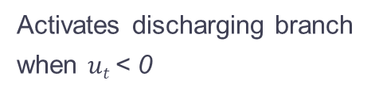

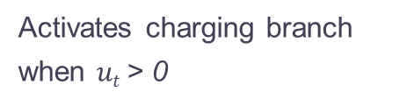


Constraints: Smooth power mapping (2)
Non-differentiable switching at SOC limits is approximated by smooth tanh-based gates, enabling gradient-based solvers.
The gated power map becomes:
$σ$_{k}($ut−ε)$
$σ$_{k}($−ut−ε)$
$$σ\text{k}\text{(}0.995−SOCt)$$
$σ$_{k}(SOC_{t}$−0.005)$
Activates charging branch when $ut$> 0
Activates discharging branch when $ut$< 0
Suppresses charging near full (SOC≈1)
Suppresses discharging near empty (SOC≈0)
Parameters: dead-band offset $ε$ = 0.0025; steepness k controls sharpness of the gate transition. Larger k approaches a hard switch.

Slide 5




Constraints: Efficiency Model & SOC Dynamics (3)
Efficiency Map
State-of-Charge Recursion
A factor $η$ is applied to both charge and discharge:
With Δt = 3600 s and capacity E_{max}:
Implementation uses $η$ = 0.9.
Each step integrates effective battery power into the energy state, enforcing causality across the horizon.

Slide 6
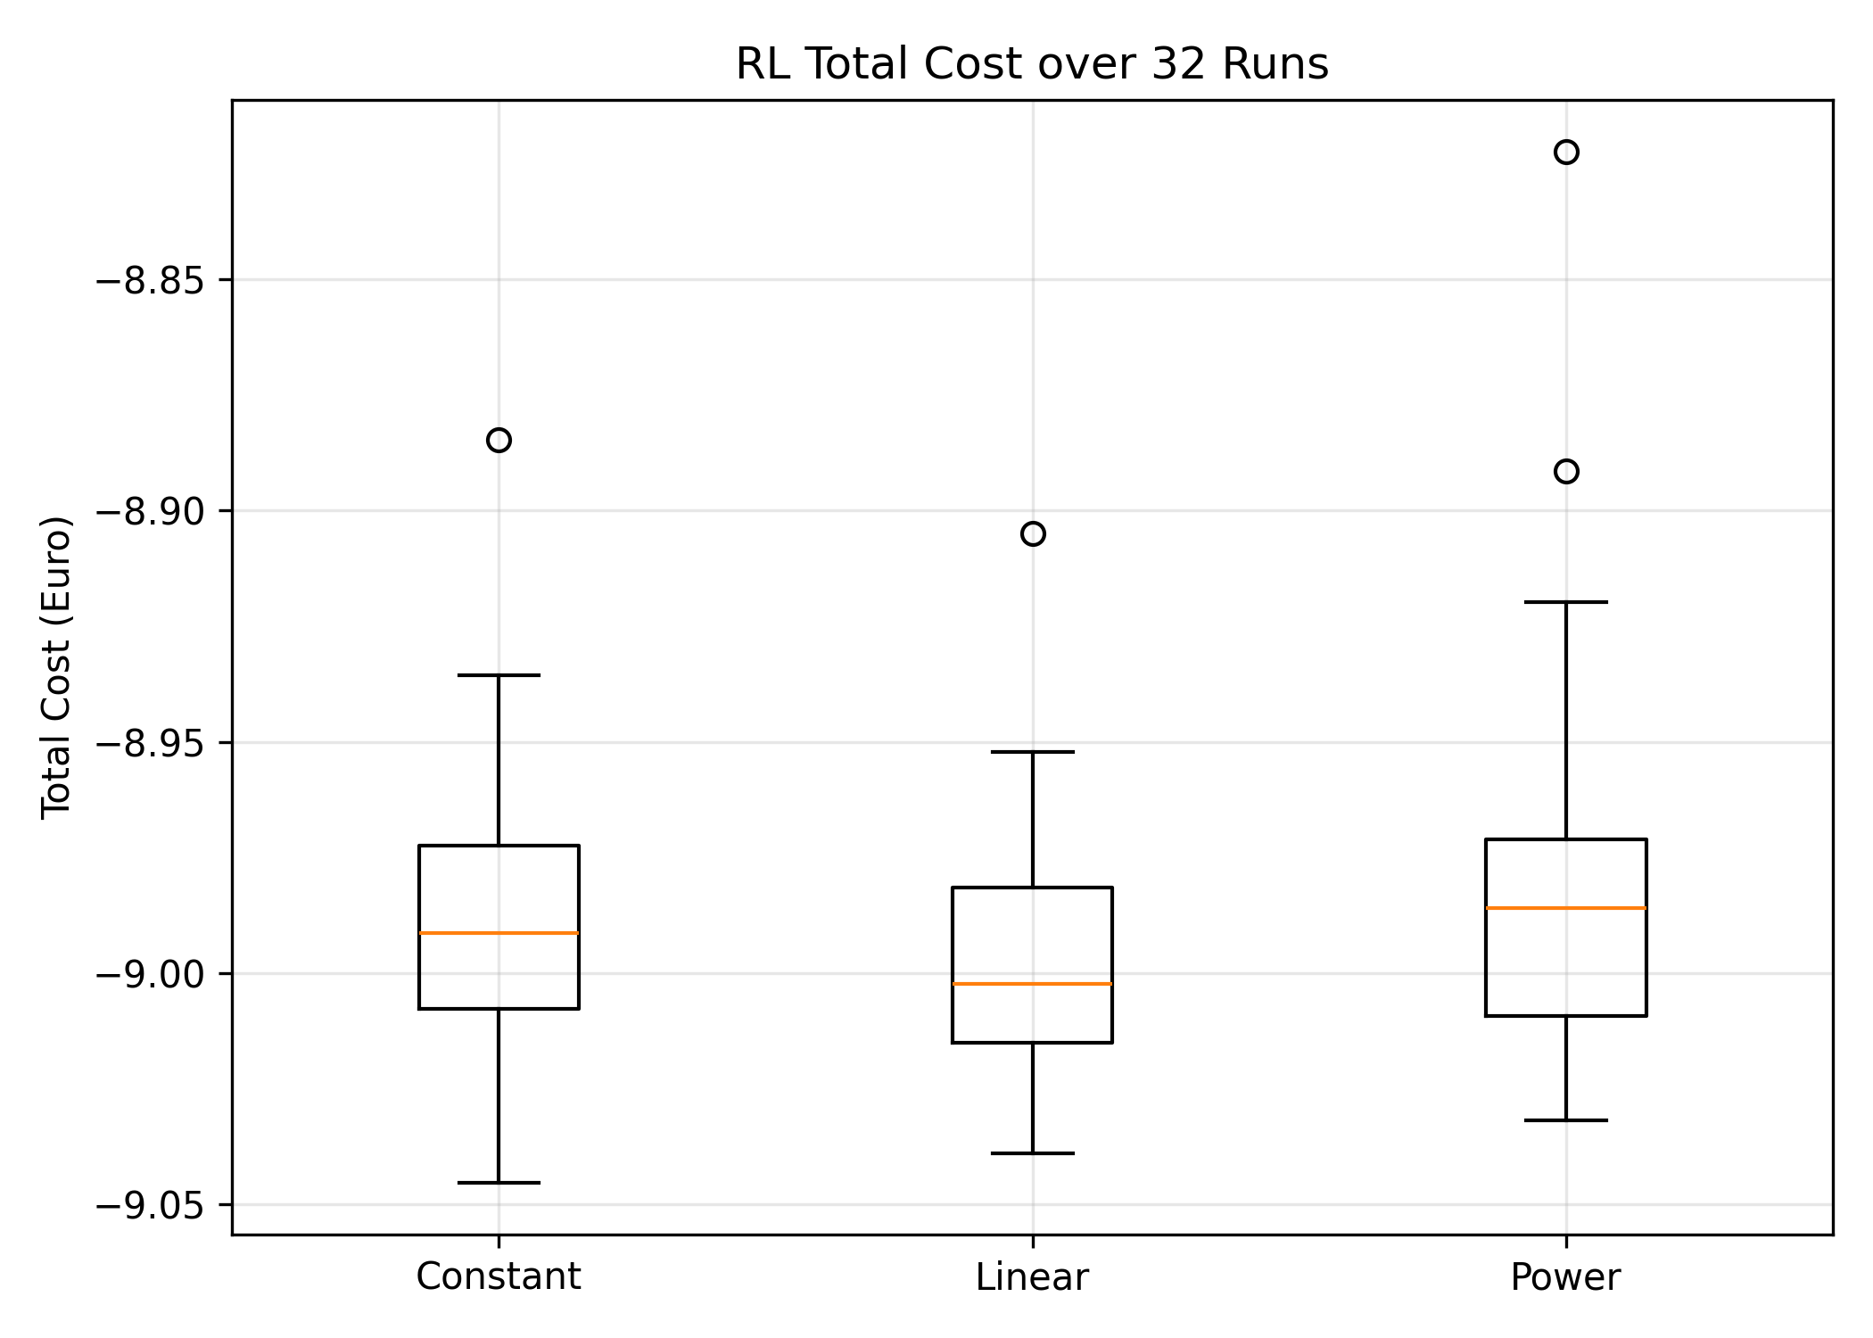
Analysis of RL Battery Optimization Box Plot (32 Runs)
Fig.: Distribution of total cost from 32 RL models trained with identical hyperparameters and evaluated over the same time horizon.
* Mathematical Optimization Cost: -10.12 €

Slide 7
Analysis of RL Battery Optimization Box Plot (32 Runs)
The linear learning rate schedule performs best because it achieves the lowest median cost and maintains a tight distribution across runs, indicating stable and reliable convergence. The linear decay allows large updates during early exploration and smaller updates for fine policy refinement later in training.
Strengths:
31/32 runs (96%) achieved near-optimal performance
Stable and consistent learning behavior
Model is robust to random initialization
Weaknesses:
4% chance of suboptimal convergence (1 outliers)
Optimality of the learned policy cannot be guaranteed

Slide 8
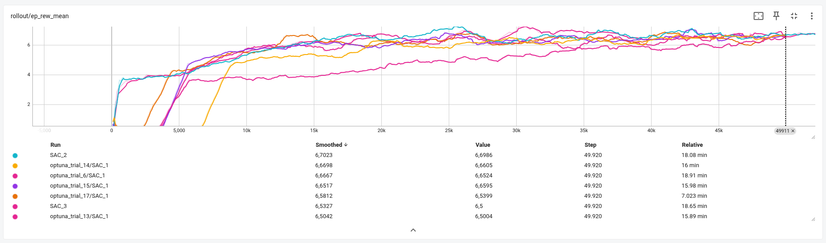
Hyperparameter Tuning: Training Performance Comparison
Fig: Comparison of episode rewards across multiple SAC training runs with different hyperparameter configurations.

Slide 9
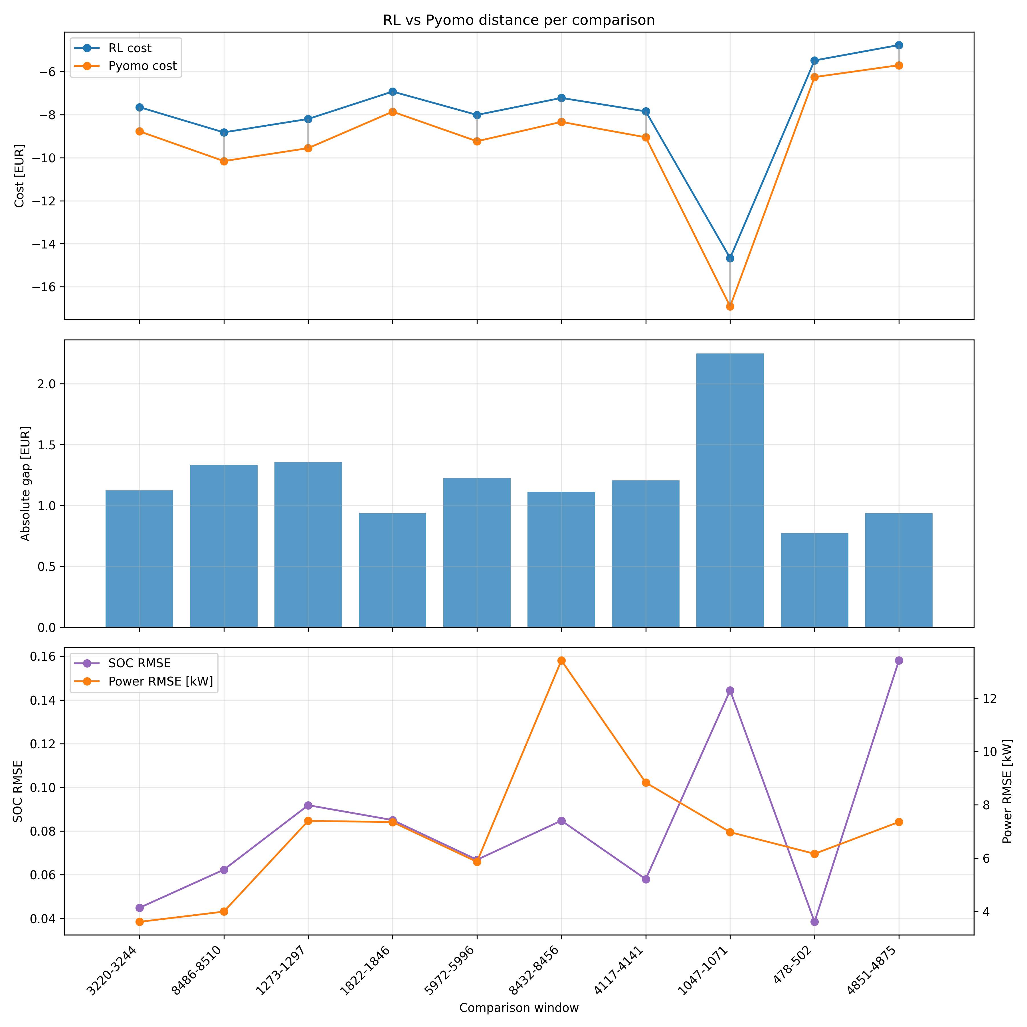

Slide 10
Computational Time Comparison
Method | Time
RL Training | ≈ 16 minutes
RL Policy Execution | 0.02 seconds
Optimization | 0.16 seconds
Although RL requires higher upfront training time, the decision-making during operation is significantly faster than classical optimization, making RL suitable for real-time control applications.

Slide 11
Thank You!
I appreciate your time and attention.

Slide 12
slides for RL(how it works)
Plot for hyperparameter tuning comparision
Create a table of content.
Number of pages you can write
Template (description)
American or british english to use
Email subject format
Time for each model.

